Slide 1
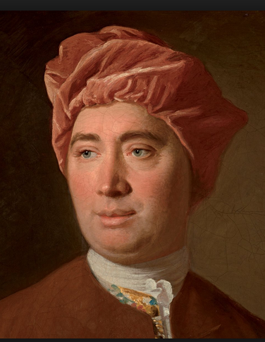
David Hume Liberal Political Theory GMU 27 Nov 2018 Youtube video: https://youtu.be/7cNI1uC620c
By Daniel Klein and Erik Matson
Notes:
I am thrilled and grateful for this opportunity. Thank you all.

Slide 2
“Mere-liberty in David Hume”
Erik W. Matson
GMU PhD 2017
NYU Postdoc
Works on Hume and Smith

Slide 3
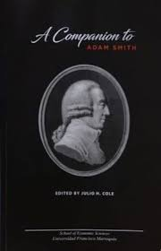
A Companion to David Hume
Edited by Moris Polanco
Universidad Francisco Marroquin (UFM)

Slide 4
Related Dan Klein videos
The Semantic History of Liberalism (20 min)
https://newmedia.ufm.edu/video/semantic-history-of-liberalism/
Liberalism 1.0: The Genealogy of Adam Smith’s Liberalism (66 min)
https://newmedia.ufm.edu/video/liberalism-1-0-the-genealogy-of-adam-smiths-liberalism/
Adam Smith’s Commutative, Distributive, and Estimative Justice (55 min)
https://www.youtube.com/watch?v=JBA6Z1qJH5I&feature=youtu.be
Niche Libertarianism: A Critique (39 min)
https://www.youtube.com/watch?v=7E1GiyTDz4w&feature=youtu.be

Slide 5
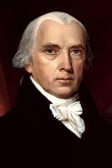
James Madison
“Among the difficulties encountered by the [Constitutional] Convention, a very important one must have lain, in combining
the requisite stability and energy in Government,
with the inviolable attention due to liberty,
and to the Republican form.”
Federalist Paper #37 (p. 252)

Slide 6
Mere-liberty:
Others not messing with one’s stuff
In particular: The government

Slide 7
Paradox
“A great sacrifice of liberty must necessarily be made in every government”
"liberty is the perfection of civil society"
But "authority must be acknowledged essential to its very existence" (EMPL 40).

Slide 8
“liberty” in Hume
"personal liberty”
"civil liberty”
"political liberty”
"English liberty”
"established liberty”
"general liberty”
"public liberty”
“regular liberty”
“plan of liberty”
“natural liberty”
“native liberty”
“liberty”: ~ 700 in History.

Slide 9
I learned…
Mere-liberty in Hume
The role of natural jurisprudence in liberal political theory
The importance of jural integration in liberal political theory: The liberal nation-state
The jural logic of one’s own
The arc and character of liberalism 1.0

Slide 10
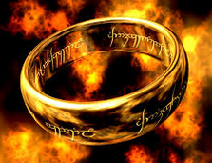
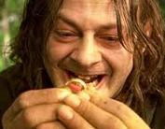
1440-1776
Gutenberg printing press 1440.
Protestant reformation: Innovation and secession from Roman Catholicism
Cuius regio, eius religio: Whose realm, his religion.
Wars of religion
An idea: Religious toleration
Another idea: Liberty of religion.
Separation of Church and State
Another idea: Liberty.
Separation of High Things and State.
Adam Smith:
“more difficult to preserve
this harmony [of sentiments]”
Meanwhile:
The rise of the nation-state
Notes:
The printing press empowered intellectuals to innovate and criticize traditional power.
There came innovation and secession from Roman Catholicism. But cohesionism was still the plan, just a different religious doctrine.
Cuius regio, eius religio COO-IUS REGIO AY-IUS RELIGIO. Whose realm, his religion.
People butchered each other in wars of religion, fighting over the ring of power.
Some intellectuals promoted religious toleration.
Then, liberty of religion, even a free market in churches and religion.
And then, a free-market, period. The separation of High Things and State.
Meanwhile, we had the rise of the nation-state.

Slide 11
Arthur Melzer:
“[E]arly modern thinkers…endeavored to find a form of politics that could do without such consensus. They deliberately set out to subvert traditional society and to replace it with a fundamentally new kind of social organization, one that would renounce the ever precarious attempt to define the truth about life’s highest goods. Instead, it would unite men on the promise of preventing the most obvious and basic evils…Thus, by standing traditional society on its head, by openly switching the purpose and moral basis of the state from our highest to our lowest end, they attempted to separate politics from the whole disputed sphere of morality and religion…” (2014, 171)
Notes:
Arthur Melzer writes:

Slide 12
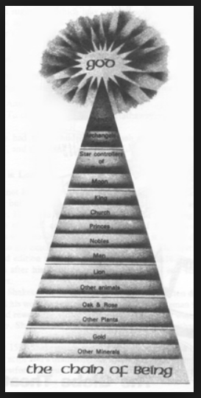
High things, sacred things. Low things, mundane things.
The low things
Clarifying pieces: Dividing and subdividing rights and duties
Natural jurisprudence
Basic rules: operating system
“the liberal plan”
dangers of discohesion
a faith in spontaneous order
Notes:
To refocus on the low things, they had to clarify them, by dividing and subdividing rights and duties.
To create basic rules, a basic operating system.
The basic operating would emerge as “the liberal plan.”
They were acutely aware of the dangers of discohesion.
But they had adequate faith in spontaneous order, good enough to justify movement in the liberal direction.

Slide 13
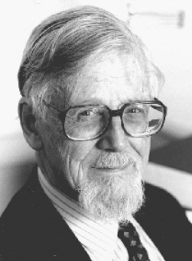
J.G.A. Pocock
“The child of jurisprudence is liberalism, in which the disjunction between individual and sovereign remains, no matter how close the two are brought to one another; whereas republican virtue pertains immediately to the individual, not as proprietor or rights-bearer but as citizen, sharing self-rule among a number of equals without the need of any prior translatio.” (essay in Hont & Ignatieff 1983, 249)

Slide 14
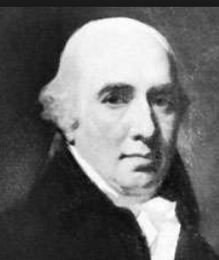
Dugald Stewart
The systems of natural jurisprudence were “the first rudiments…of liberal politics taught in modern times.” (CW I, p. 26, see also 183)
And to which “we are chiefly indebted for the modern science of Political Economy” (p. 171)

Slide 15
Some genealogy of liberalism 1.0
“proto-liberals”
→ Political stability in Britain
Grotius-Locke-Hume
Hume-Smith
“liberal” as the name
1600 1689 1776 …. Gladstone….
We extend “liberal” backward in time, before 1776
Notes:
Grotius-Locke-Hume are a tradition…
We extend “liberal” back before 1776.
“proto-liberals”

Slide 16
Hume scholarship
Our take broadly concurs with:
Frederick Whelan
Knud Haakonssen
Nicholas Capaldi
Russell Hardin
Thomas Merrill

Slide 17
Others shy on mere-liberty
 | what is highlighted as central in Hume’s meaning of liberty
John Valdimir Price (1966) | “individual activities and expressions of ideas that are not inimical to the stability of the government” (p. 141)
Friedrich Hayek (1967) | “general and inflexible laws” (117f)
Duncan Forbes (1975) | “the security of the individual under the rule of law” (87, also 88, 153); “general and equal laws” (154f); "the absolute rule of law" (170, 181)
David Miller (1981) | “the absence of arbitrary coercion” (148)
John B. Stewart (1992) | “civil liberty entails a rule of law; it requires established rights with respect to economic activity, speech, religion, and so forth” (232)
Donald Livingston (1998) | “uncoerced by the arbitrary will of another,” “a government of Laws, not of Men,” “Law must be known, regular, and predictable," “the rule of law” (182f)
Andrew Sabl (2012) | “strategies and institutions for limiting the power that accrues to those who hold power under conventions of authority” (16); “general and inflexible laws” (206)

Slide 18
“transportation”
Is a car transportation?
Essential meaning:
Moving things from one place to another
Contributory meaning:
Things that contribute to moving things from one place to another

Slide 19
“liberty”
Essential meaning:
Others not messing with one’s stuff
Contributory meaning:
Things that contribute to others not messing with one’s stuff

Slide 20
James Madison
“Among the difficulties encountered by the [Constitutional] Convention, a very important one must have lain, in combining
the requisite stability and energy in Government,
with the inviolable attention due to liberty,
and to the Republican form.”
Federalist Paper #37 (p. 252)

Slide 21
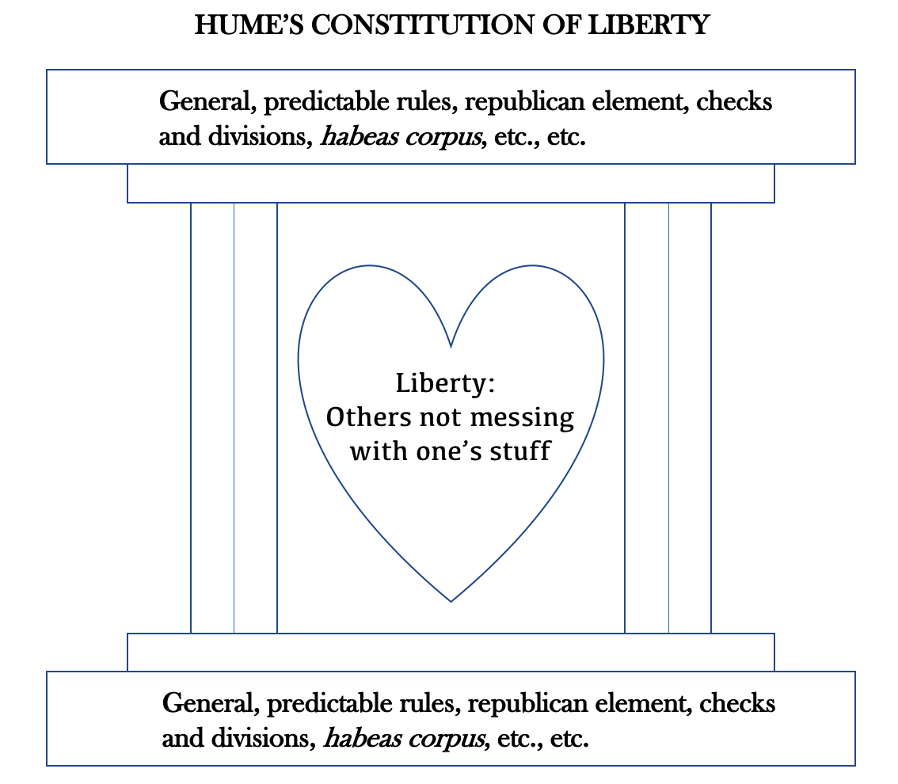

Slide 22
Polysemy, contrarieties
Hume:
nature, natural
reason
liberty, freedom
justice
Smith:
nature, natural
justice
impartial spectator

Slide 23
Others not messing with one’s stuff
is flipside of
Not messing with other people’s stuff
COMMUTATIVE JUSTICE -- CJ

Slide 24
“abstaining”
In THN, Hume uses abstain and its cognates NINE TIMES:
“by abstaining from the possessions of others”
"...particular goods are to be assign’d to each particular person, while the rest of mankind are excluded from their possession and enjoyment" (T 3.2.3.1, italics added)
"A man's property is suppos'd to be fenc'd against every mortal, in every possible case" (T 3.2.1.16).
CJ: “abstaining from what is another’s”

Slide 25
abstaining from | = | not messing with
what | = | stuff
another's | = | other people's

Slide 26
Commutative justice:
Not messing with
other people’s
stuff
Understood within historical context.
Uniformity amidst variety.
Government law affects fine points but does not undo natural conventions
Notes:
…
General formulation but…
Uniformity amidst diversity.
Government law affects fine points but does not undo natural conventions

Slide 27
Commutative justice
“The most sacred laws of justice…are the laws which guard the life and person of our neighbour; the next are those which guard his property and possessions; and last of all come those which guard what are called his personal rights, or what is due to him from the promises of others.”
Notes:
Commutative justice a one of those virtues you are to practice…

Slide 28
Self-ownership
“There are three different species of goods, which we are possess’d of; [1] the internal satisfaction of our minds, [2] the external advantages of our body, and [3] the enjoyment of such possessions as we have acquir’d by our industry and good fortune.” (T 3.2.2.7)
Men "must seek for a remedy, by putting these goods, as far as possible, on the same footing with the fix’d and constant advantages of the mind and body. This can be done after no other manner, than by a convention" (T 3.2.2.9; italics added).

Slide 29
Self-ownership
“the most considerable of all goods, life and limbs" (T 3.2.8.1)
"our natural liberty," "native liberty" (EMPL 588 n6, 580)
the English government's obligation "to secure every one's life" (EMPL 12)

Slide 30
In the History
captives/prisoners/slaves recovering their liberty/being restored to liberty/etc.: I: 142, 143, 149, 172, 224, 231, 260, 265, 291, 384, 396, 398, 401, 402, 403, 409, 469; II: 48, 58, 58, 61, 62, 79, 89, 93, 113, 124, 187, 190, 191, 244, 253, 259, 260, 330, 334, 387, 417, 424, 472, 488; III: 22, 35, 36, 67, 70, 75, 159, 162, 163, 164, 166, 167, 174, 175, 229, 240, 270, 294, 296, 297, 305, 379, 382, 405, 406, 407, 428; IV: 7, 8, 50, 80, 98, 124, 128, 130, 132, 156, 157, 171, 180, 190, 198, 201, 202, 232, 296, 327, 335; V: 62, 63, 74, 216; VI: 9, 13, 33, 88, 124, 133, 228, 327, 371, 529.
liberty of thought/conscience/religion: I: 393; III: 136, 189, 212, 266, 289, 322, 342, 384, 433; IV: 19, 150, 168, 211; V: 115, 125; VI: 71, 88, 139, 184, 250, 254, 364, 377, 389, 398, 482.
liberty of press/speech: III: 345; IV: 140, 180, 285; V: 91, 92, 130, 190, 240; VI: 540, 542.

Slide 31
Property extended, Contract
By emergent conventions:
new objects permanently owned, propertized
signs and words for contract

Slide 32
CJ conventions
any property/contract rule or principle that emerges “admits not of degrees” (T 3.2.6.8)
“precise and accurate” – Smith
Like grammar

Slide 33
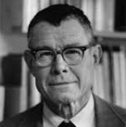
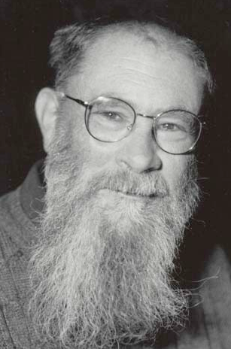
David Hume
Thomas
Schelling
1921-2016
Problems in mutual coordination
Focal points (Schelling)
Focal points all the way down.
Convention: Language, etc. (D.K. Lewis)
Does not imply contract/consent.
David K.
Lewis
Convention
Consent
Notes:
He fathomed questions of mutual coordination about as brilliantly as anyone prior to Thomas Schelling.
He tended to see things as focal points all the way down.
He spoke of language as convention, like David K. Lewis later.
Convention does not imply contract or consent, it is a broader concept.

Slide 34
David Hume
Natural convention
Commutative justice: A set of conventions.
Political authority: A set of conventions.
He attacks social contract
“liberty is the perfection of civil society” Essays, 41
Convention
Consent
Notes:
Some conventions are natural, in the sense that they are quite necessary to any social system that survives, and in that sense universal.
He attacked social contract and instead interpreted political authority in conventionalist terms. So political authority would be here, as conventional but not a matter of contract or consent.
And he did likewise for commutative justice.
He said liberty was the perfection of civil society, but he knew that perfection was something not fully attainable and that the very idea of such perfection was fraught with internal tensions and paradoxes.

Slide 35
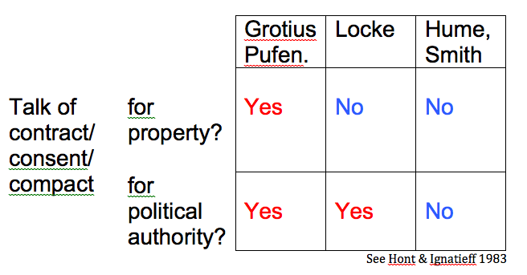

Slide 36
“’Tis sufficient to observe on this occasion, that property may be defin’d, such a relation betwixt a person and an object that permits him, but forbids any other, the free use and possession of it, without violating the laws of justice and moral equity. If justice, therefore, be a virtue, which has a natural and original influence on the human mind, property may be look’d upon as a particular species of causation; whether we consider the liberty it gives the proprietor to operate as he pleases upon the object, or the advantages, which he reaps from it.” (T 2.1.10.1; italics original, boldface added)

Slide 37
“[T]he convention for the distinction of property, and for the stability of possession, is of all circumstances the most necessary to the establishment of human society, and that after the agreement for the fixing and observing of this rule, there remains little or nothing to be done towards settling a perfect harmony and concord.” (T 3.2.2.12; italics added)

Slide 38
Knud Haakonssen
For Hume:
"The object of just laws is thus individual liberty, and, since the most obvious and most endangered expression of such liberty is the acquisition and use of property, justice is centrally concerned with property and, it follows, with contracts” (1996, 117).

Slide 39
Pinning down mere-liberty
"stuff”?
"one’s”?
"messing with"?

Slide 40
Stable polity in Britain
Hume and Smith presuppose a stable polity context.
Notes:
Not long after the Glorious Revolution, Britain attained robust political stability. Our next heroes, Hume and Smith, lived in and wrote for such a world, presupposing a stable polity. That is one reason why we find it much easier to understand Hume and Smith than to understand the 17th century writers.

Slide 41
Jural integration, Stable polity
"the government"
Integration of municipal, county, provincial, national authorities.
Stable polity
The modern nation-state: A stable polity of jural dualism
Two kinds of jural relationships:
Equal-Equal (E-E)
Superior-inferior (S-i)

Slide 42
The jural logic of one’s own:
For such societies:
A type of action in S-i is an initiation of coercion if and only if such action in E-E is.

Slide 43
S-i E-E
taxation extortion
arrest abduction
regulation, intervention assault
asset seizure theft
conscription slavery

Slide 44
"municipal laws" may "fix what the principles of human nature have left undetermin’d" (T 3.2.3.10 n75.13)
Historicity pins down "stuff," "one's," and "messing with," yielding operative CJ and liberty.
CJ and liberty need historicity to pin down the specifics of the social grammar, but as general formulations they achieve a uniformity pervading all such societies.

Slide 45
Jural integration makes the liberty maxim meaningful
“the liberal plan”

Slide 46
But…
suppose no integration:
families
clans (Highlands)
master-slave relationships
tribes
barons and lords
ecclesiastical institutions
multiple unstable kings, chieftains, rulers (Jacobites 1715, 1745)
guilds and corporations
secessionism
foreign allegiances

Slide 47
Hume’s History
Favorable to jural integration and stable polity:
“In the ancient feudal constitution, of which the English partook with other European nations, there was a mixture, not of authority and liberty, which we have since enjoyed in this island, and which now subsist uniformly together; but of authority and anarchy, which perpetually shocked with each other, and which took place alternately, according as circumstances were more or less favourable to either of them... During an unpopular and weak reign, the current commonly ran so strong against the monarch, that none durst inlist themselves in the court-party; or if the prince was able to engage any considerable barons on his side, the question was decided with arms in the field, not by debates or arguments in a senate or assembly.” (H V: 556, Note [J]; see also 533)

Slide 48
Hume’s History
“[The pre-Tudor period] required the authority almost absolute of the sovereigns, which took place in the subsequent period, to pull down those disorderly and licentious tyrants, who were equally averse from peace and from freedom, and to establish that regular execution of the laws, which, in a following age, enabled the people to erect a regular and equitable plan of liberty.” (H II: 525)

Slide 49
Andrew Sabl
“In the feudal era, they [England's barons] did not support the rule of law because in its absence they themselves were law. Civilization was a matter of bringing the barons, through a mix of force and bribery, to believe that great wealth and status among fellow subjects, under equal laws, was more desirable than a lawless and miserable domination over slaves. This was eventually a change in identity: barons became gentlemen.” (2012, 65)
~ “honest gentlemen”

Slide 50
800 AD Feudalism Modern
(king)
Allodial Lord
serf
King
lords/nobles
serf
Governor (S)
citizen (i)
Jurisprudence
highlights the
awfully special
nature of
government.
Notes:
Smith and others tell a story about the emergence of the modern nation-state, and points toward the promise of a governor or jural superior practicing liberal policy and liberal politics.
Meanwhile, jurisprudence highlights the awfully special nature of government.

Slide 51
Hume’s History
“Above all, a civilized nation, like the English, who have happily established the most perfect and most accurate system of liberty that was ever found compatible with government, ought to be cautious in appealing to the practice of their ancestors, or regarding the maxims of uncultivated ages as certain rules for their present conduct.” (H II: 525)

Slide 52
Conceptual fog, the fog of war
In the fog of jural pluralism, less clarity in translating E-E principles to form a concept of "liberty". It may not even make sense to speak of a system of E-E relationships.
Such powers battle one another, leaving liberty on the back-burner.

Slide 53
Hume, Smith, Franklin, Burke, Madison: convention-savvy civilizational leaders.
They built on anticipations of Grotius, Locke, who could not presuppose stable integrated polity.

Slide 55
Hume sees a regular system of mere-liberty as of late distillation.
Duncan Forbes: "if liberty and the constitution are modern, the Stuarts, or the first two at least, could hardly be blamed for trying to destroy something which did not then exist" (1975, 263).
Hume basically endorses the integrative work of divine right monarchy, but is then glad of how it was reconstituted, in fitful succession, by "opinion" associated with such things as print culture, commerce, and not least Puritan enthusiasm.

Slide 56
Mere-liberty talk is copious
In the History:
Copious talk that clearly implies mere-liberty
Besides “liberty”/“freedom” talk:
“prohibited,” “restraints,” “limitations,” “shackles,” “fetters,” “slavery,” ”tampering,” etc.

Slide 57
Policy judgment
Once we may presuppose stable integrated polity,
Hume favors:
Presumption of liberty
liberalization, free enterprise, degovernmentalization of social affairs

Slide 58
Hume
An establishment political philosopher—“conservative”
But:
Not an establishment political economist–“liberal” in presumption of liberty.
Likewise Smith and Burke
(D. Miller, D. Livingston, T. Merrill, N. Capaldi, Y. Levin, R. Bourke)

Slide 59
Some scholars have been shy on seeing mere-liberty in Hume.
And some have disputed the drift of our paper and this presentation.
My view:
Hume&Smith = classical liberalism

Slide 60
Why the unclarity?
Paradoxes
Taboos
Thomas Merrill:
“Hume’s model is Socrates rather than Newton” (2015, 8).

Slide 63
Thank you for your attention!

